Slide 1


Teryll Felix
26th October 2022

Slide 2

Outline
Executive Summary
Introduction
Methodology
Results
Conclusion
Appendix

Slide 3
Executive Summary
Summary of methodologies
Summary of all results

Slide 4
Introduction
Project background and context
Problems you want to find answers

Slide 5

Section 1

Slide 6
Methodology
Executive Summary
Data collection methodology:
SpaceX REST API
Web Scraping
Perform data wrangling
Generate landing Class from Outcome column
Perform exploratory data analysis (EDA) using visualization and SQL
Perform interactive visual analytics using Folium and Plotly Dash
Perform predictive analysis using classification models
Using GridSearchCV to find best fit model

Slide 7
Data Collection
Describe how data sets were collected.
You need to present your data collection process use key phrases and flowcharts

Slide 8
Data Collection – SpaceX API
Notebook Link
REST API
SpaceX REST API
JSON
DataFrame

Slide 9
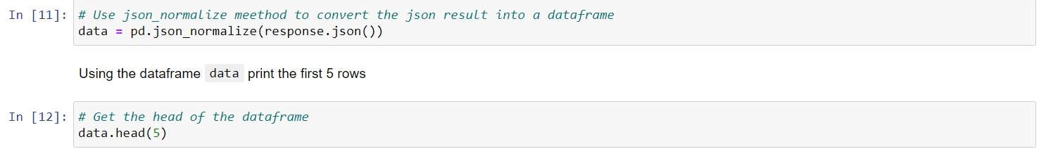
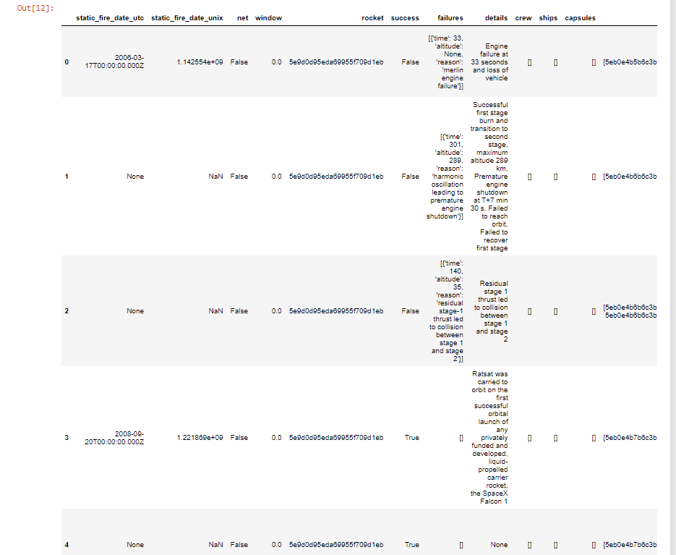
Screenshot of SpaceX API Call
Screenshot of SpaceX API Call Outcome

Slide 10
Data Collection - Scraping
Notebook Link
Web Scraping
Wikipedia Page
https://github.com/TF758/IBM-DS-Capstone-Project/blob/7e255d037daf6a336e26c665c149caf7fcf08831/Week%201/jupyter-labs-webscraping.ipynb
HTML
DataFrame

Slide 11
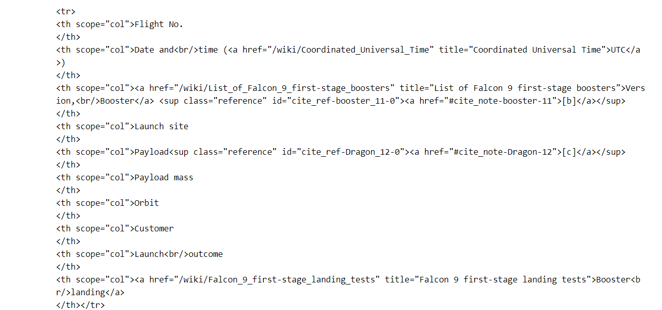
Data Collection – Scraping Results
import requests
from bs4 import BeautifulSoup url = 'https://en.wikipedia.org/wiki/List_of_Falcon_9_and_Falcon_Heavy_launches'
response = requests.get(url)
html_data = response.text
soup = BeautifulSoup(html_data)

Slide 12
Data Wrangling
Notebook Link
https://github.com/TF758/IBM-DS-Capstone-Project/blob/7e255d037daf6a336e26c665c149caf7fcf08831/Week%201/labs-jupyter-spacex-Data%20wrangling.ipynb
Transform raw data to a useful data format. For example, convert original outcome labels into landing class that represent landing classification which will be our new landing prediction target.

Slide 13
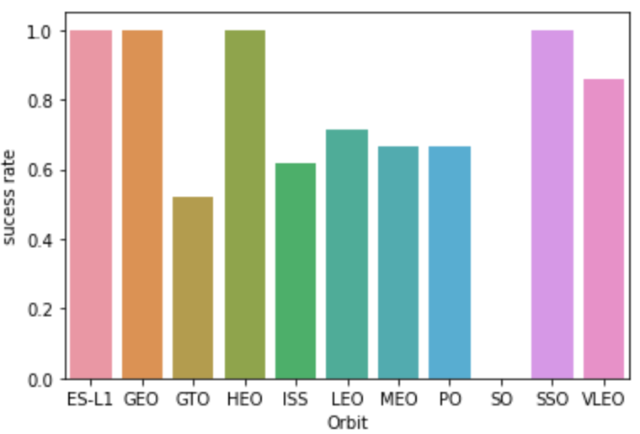
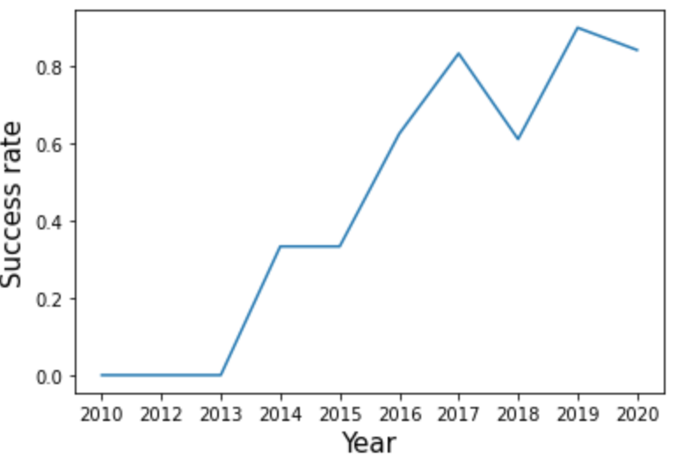
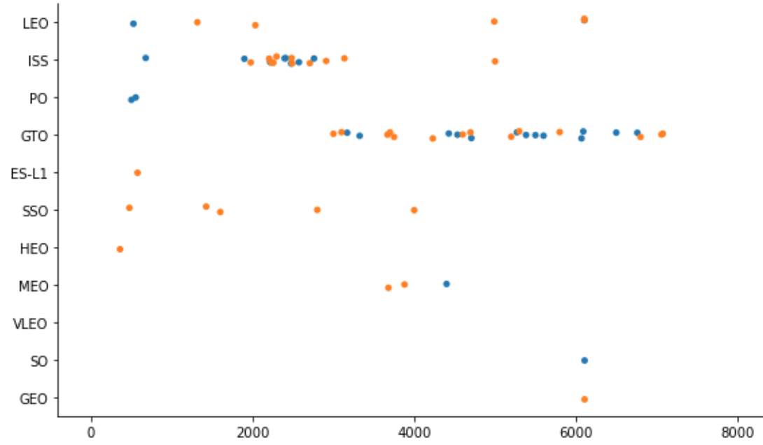
EDA with Data Visualization
Notebook
https://github.com/TF758/IBM-DS-Capstone-Project/blob/6632d90fc2f7419f253dae6e67e046561e464224/Week%202/jupyter-labs-eda-dataviz.ipynb
The scatterplot graph was used to find the relationship between 1 or more variables
A line graph was used to get the yearly average launch success trend
A Bargraph was use to compare the success rates of each orbit

Slide 14
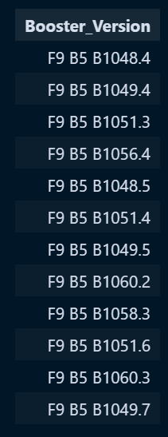
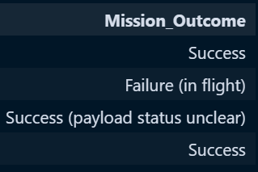
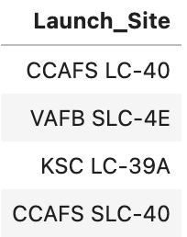
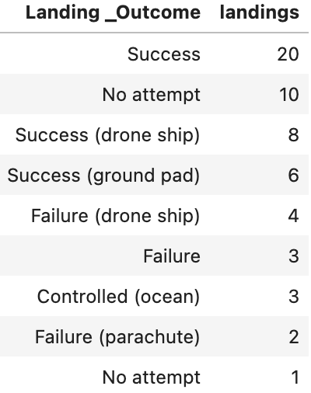
EDA with SQL
Query the names of the unique launch sites in the space mission
Query the names of the booster_versions which have carried the maximum payload mass.
List the total number of successful and failure mission outcomes
List the names of the boosters which have success in drone ship and have payload mass in some range
Rank the count of successful landing_outcomes in date range in descending order.
14

Slide 15
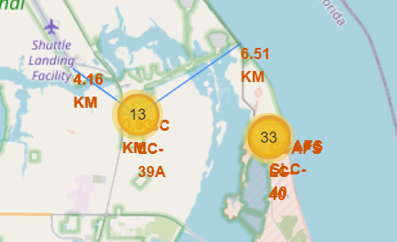
Build an Interactive Map with Folium
Add Circles for Launch sites and Markers for labels
Add Lines for calculate distance between launch sites and their proximities
Notebook
https://github.com/TF758/IBM-DS-Capstone-Project/blob/c9b32a1e6005ada3c26b1ee1ff320eaa15fcb165/Week%203/jupyter_launch_site_location_folium.ipynb
15

Slide 16
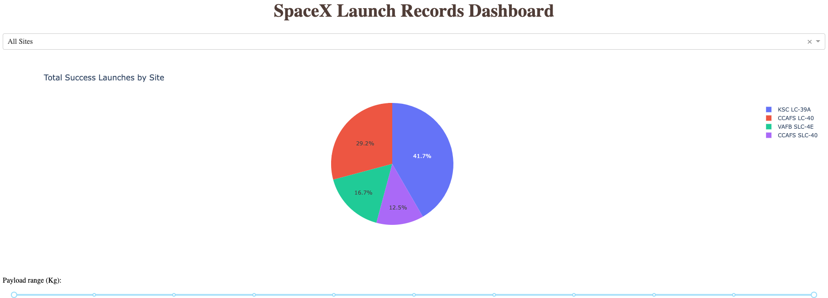
Build a Dashboard with Plotly Dash
With a Dropdown menu and a Pie Chart, we can get success launches distribution by launch site
With a Range Slider and a Scatter Plot, we can analyze the correlation between Payload and Success for different launch sites
Github Link
https://github.com/TF758/IBM-DS-Capstone-Project/blob/01b435ca23db6449822d8c78891423500303a226/Week%203/spacex_dash_app.py

Slide 17
Predictive Analysis (Classification)
Data Preprocessing
Define Model
Model Training
Model Evaluation
Data Cleaning,
Data Transformation
Splitting Data set
Choose Model
and Parameters
Train Model using Dataset
Model Plot
Notebook
https://github.com/TF758/IBM-DS-Capstone-Project/blob/01b435ca23db6449822d8c78891423500303a226/Week%204/SpaceX_Machine%20Learning%20Prediction_Part_5.ipynb

Slide 18
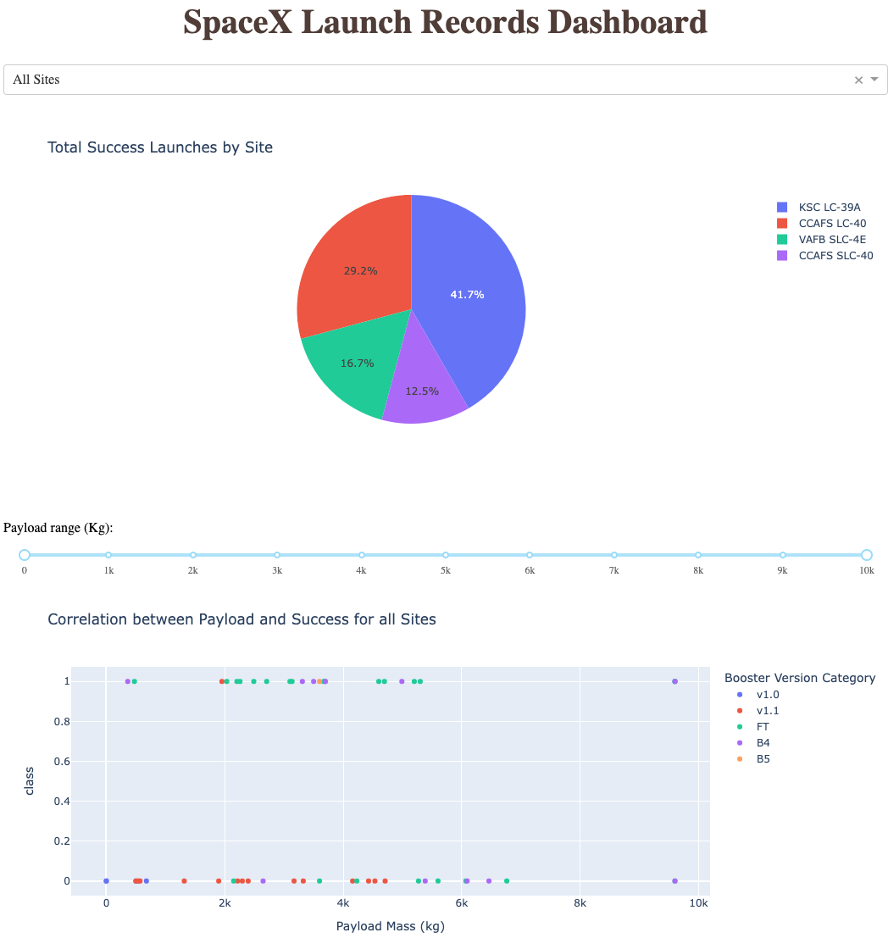
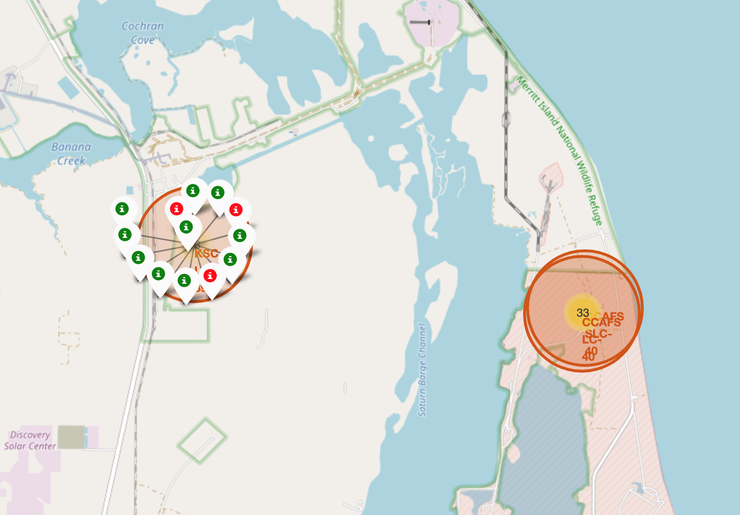
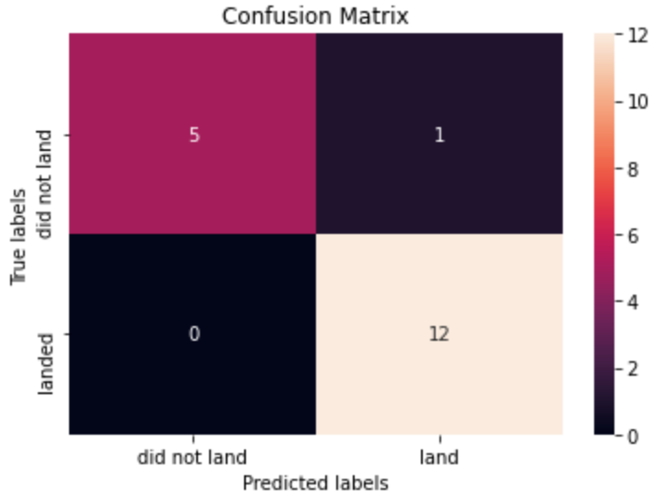
Results

Slide 19

Section 2

Slide 20
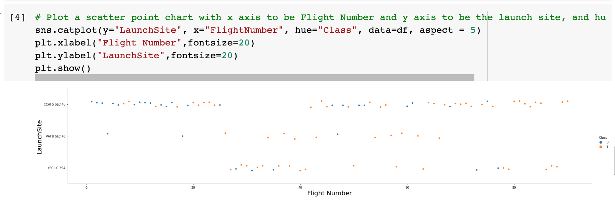
Flight Number vs. Launch Site
The general trend observed is as the total number of flights increases, so does the amount of first stage landings.

Slide 21
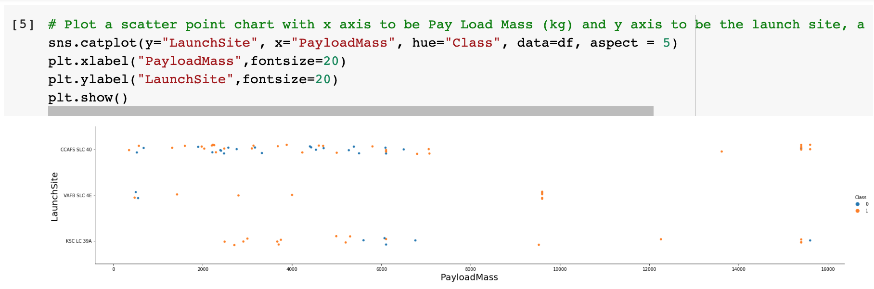
Payload vs. Launch Site
As payload mass increases, so does the success rate. However in he KSC LC391 Launch site is observed there is a much higher success rate with a low payload compared to CCAFS SLC

Slide 22
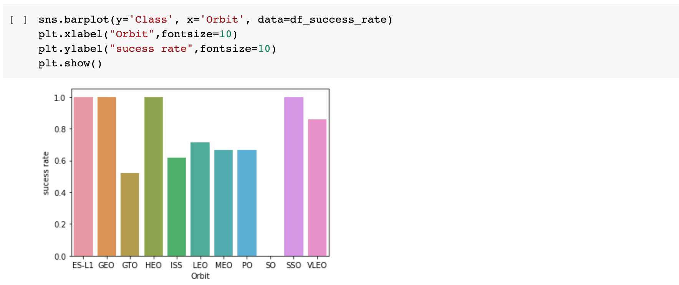
Success Rate vs. Orbit Type
ES-L1, GEO, HEO & SSO all have the highest success rate of 100% however SO has the lowest success rate with 0%

Slide 23
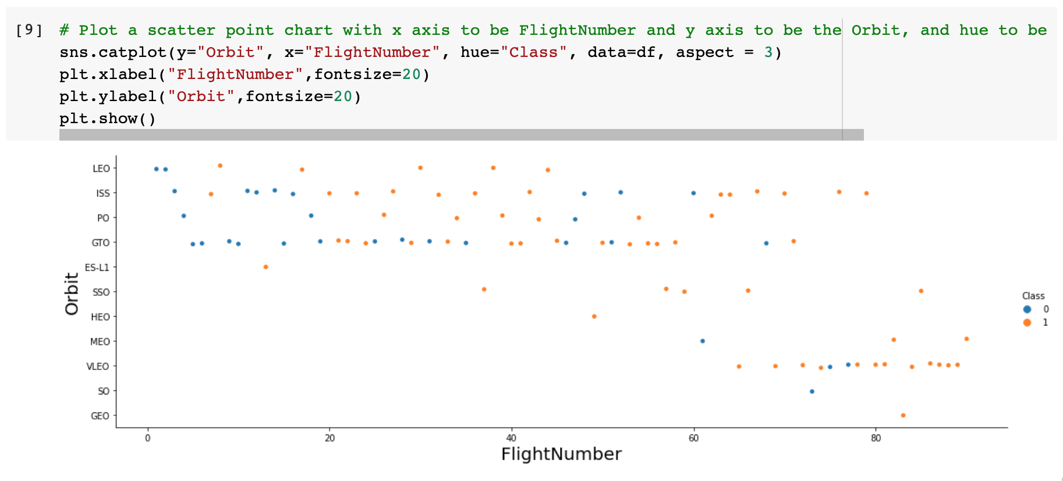
Flight Number vs. Orbit Type
In ES-L1, GEO, HEO & SS all launches are successful
As flight number increases of LEO so does the success rating indicating there is a relationship. This however can’t be seen in GTO

Slide 24
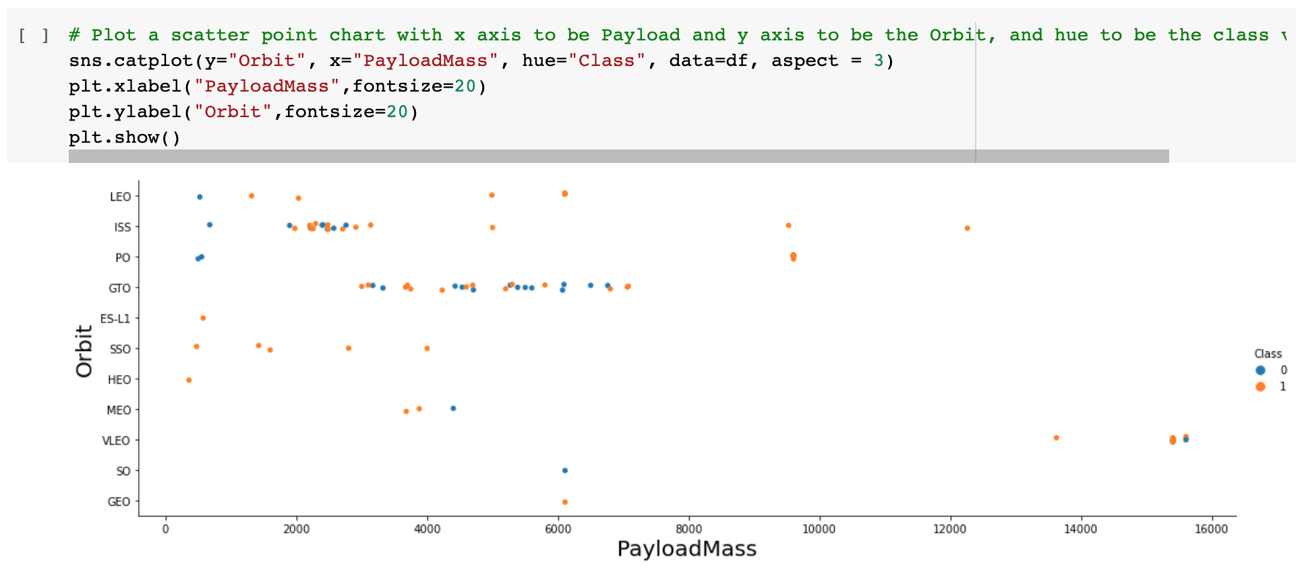
Payload vs. Orbit Type
With heavy payloads the successful landing increases for Polar, LEO and ISS. However for this is not observed for GTO

Slide 25
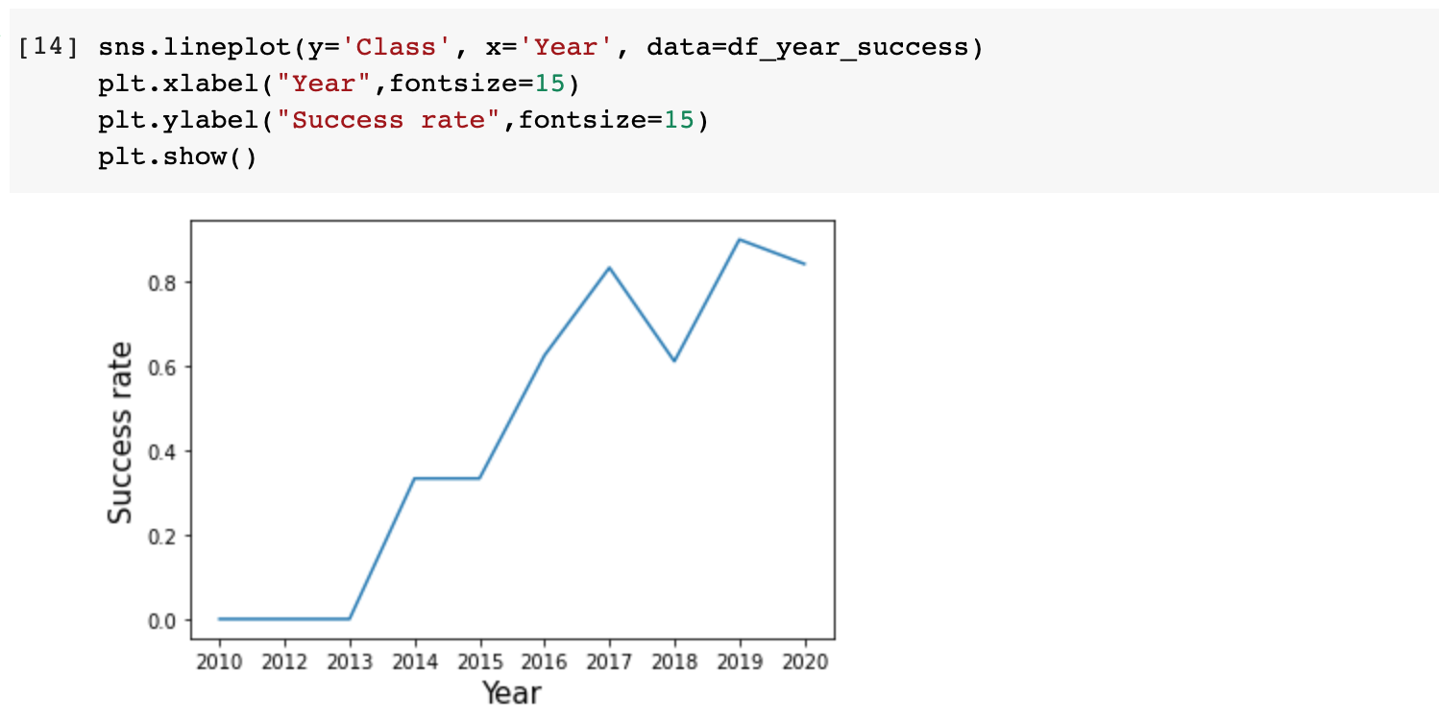
Launch Success Yearly Trend
It can be seen that the success rate increases from 2013 with a momentary dip in 2018 before continuing to increase until it dropped again in 2020.

Slide 26
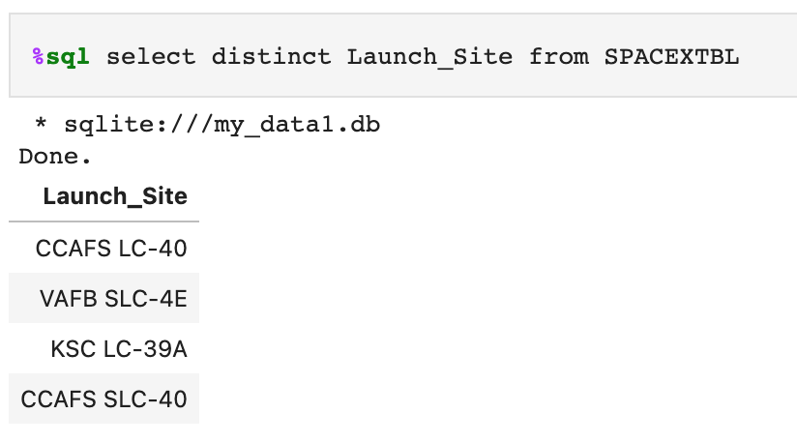
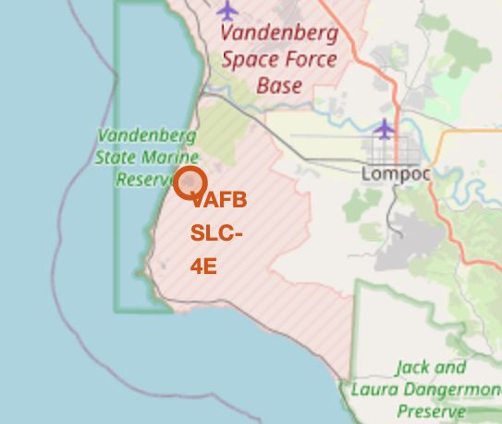
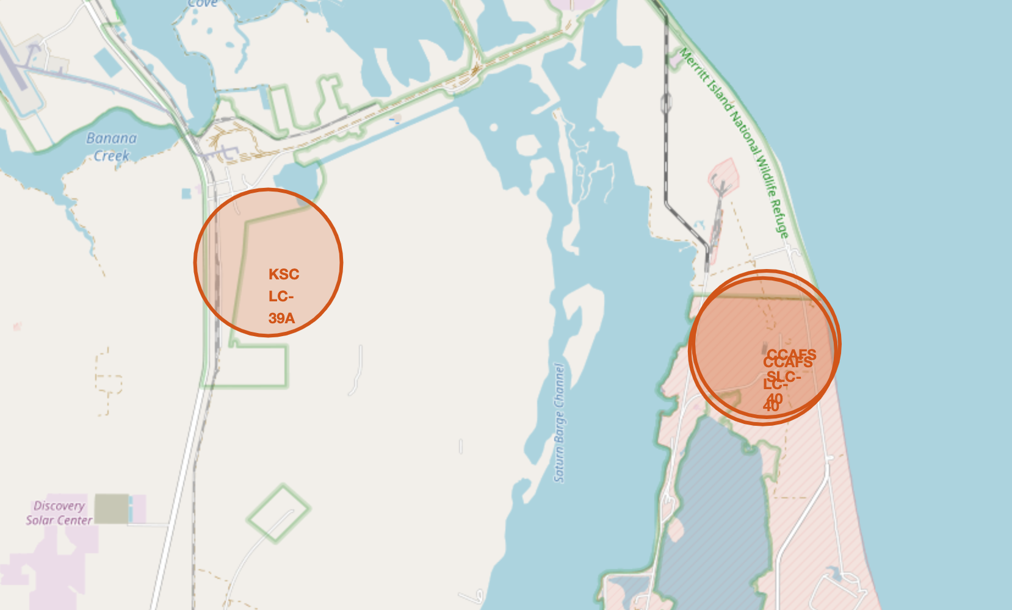
All Launch Site Names
Four Launch Sites:
CCAFS LC-40
VAFB SLC-4E
KSC LC-39A
CCAFS SLC-40
1 in western coast
VAFB SLC-4E
3 in eastern coast
KSC LC-39A
CCAFS SLC-40
CCAFS LC-40

Slide 27
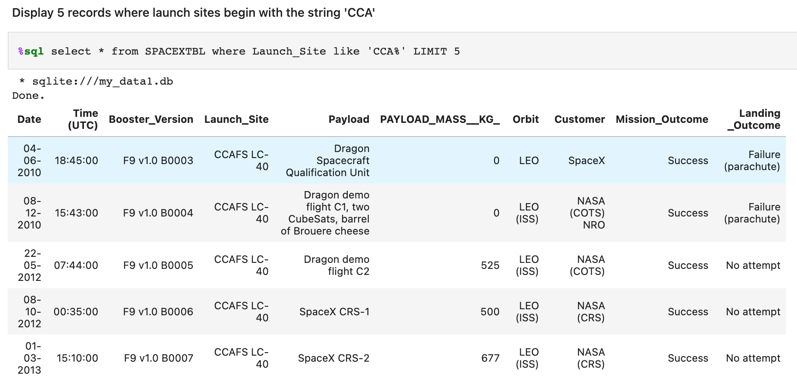
Launch Site Names Begin with 'CCA'
5 launches happened in LEO orbit, and four of them were from customer NASA.

Slide 28
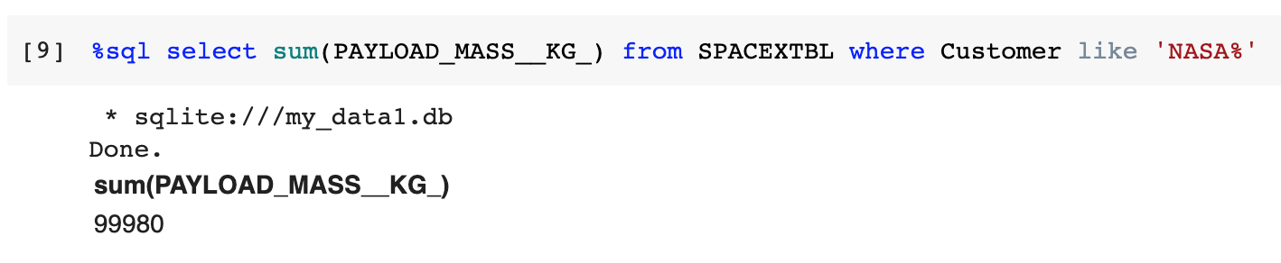
Total Payload Mass
The total payload carried by boosters from NASA is 99980.

Slide 29
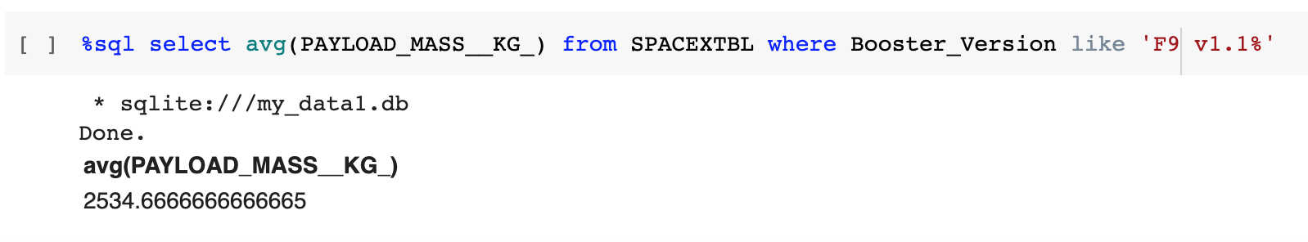
Average Payload Mass by F9 v1.1
the average payload mass carried by booster version F9 v1.1 is 2534.67.
Notes:
Calculate the average payload mass carried by booster version F9 v1.1
Present your query result with a short explanation here

Slide 30
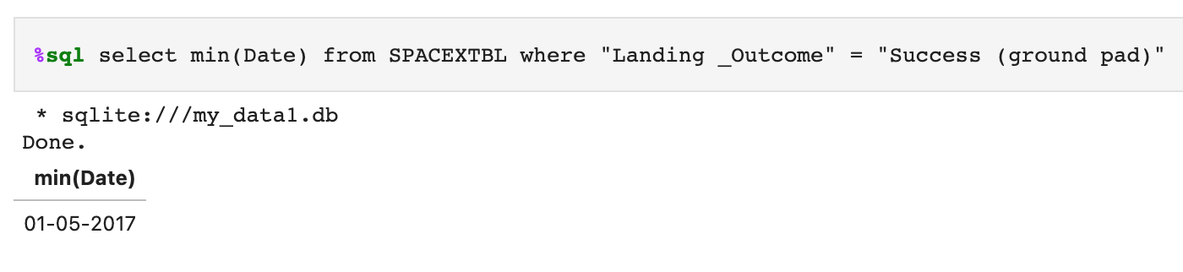
First Successful Ground Landing Date
the first successful landing outcome on ground pad is 01-05-2017.

Slide 31
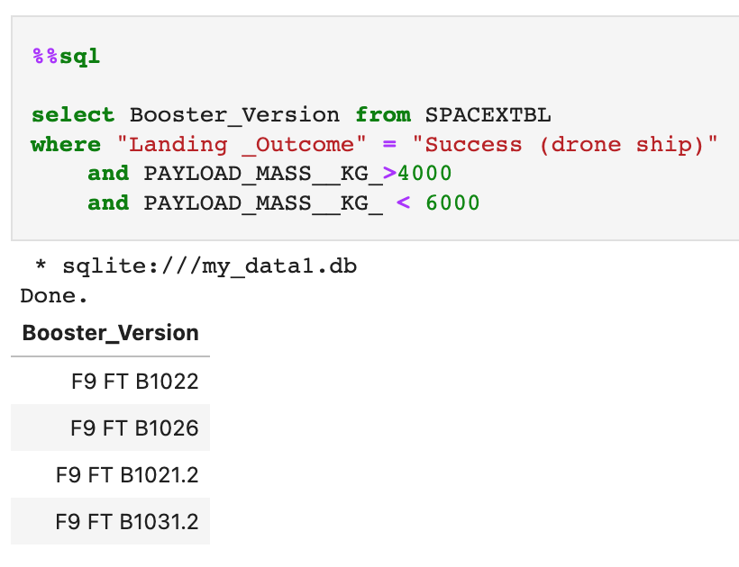
Successful Drone Ship Landing with Payload between 4000 and 6000
names of boosters which have successfully landed on drone ship and had payload mass greater than 4000 but less than 6000
F9 FT B1022
F9 FT B1026
F9 FT B1021.2
F9 FT B1031.2

Slide 32
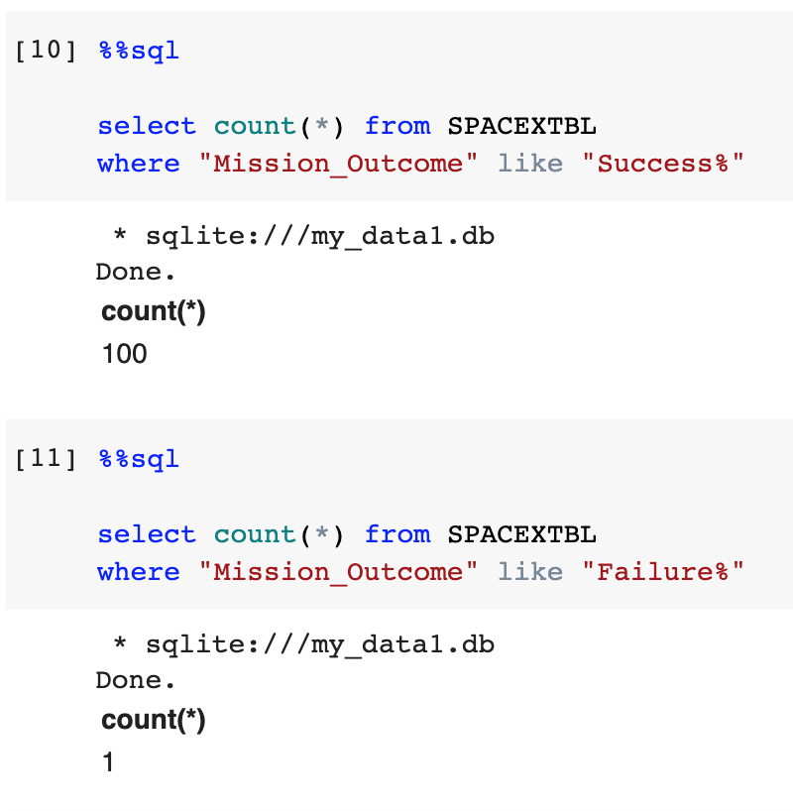
Total Number of Successful and Failure Mission Outcomes
the total number of successful mission outcomes is 100
the total number of failure mission outcomes is 1

Slide 33
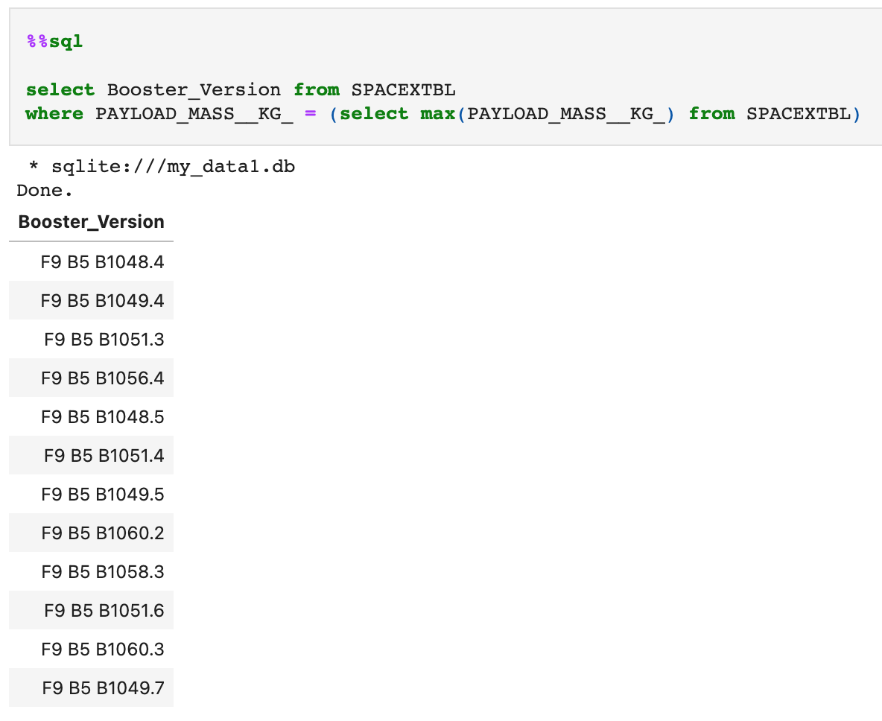
Boosters Carried Maximum Payload
Names of the booster which have carried the maximum payload mass:
F9 B5 B1048.4
F9 B5 B1049.4
F9 B5 B1051.3
F9 B5 B1056.4
F9 B5 B1048.5
F9 B5 B1051.4
F9 B5 B1049.5
F9 B5 B1060.2
F9 B5 B1058.3
F9 B5 B1051.6
F9 B5 B1060.3
F9 B5 B1049.7

Slide 34
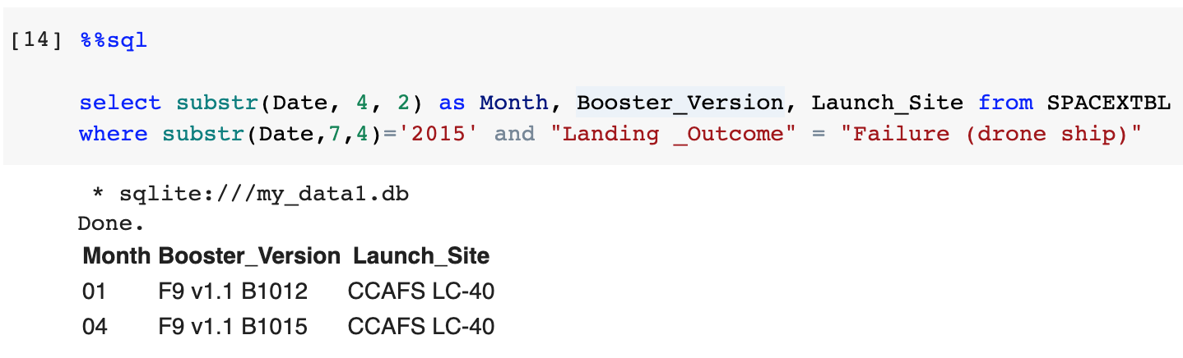
2015 Launch Records
Failed landing_outcomes in drone ship, their booster versions, and launch site names for in year 2015:
Month | Booster_Version | Launch_Site
01 | F9 v1.1 B1012 | CCAFS LC-40
04 | F9 v1.1 B1015 | CCAFS LC-40

Slide 35
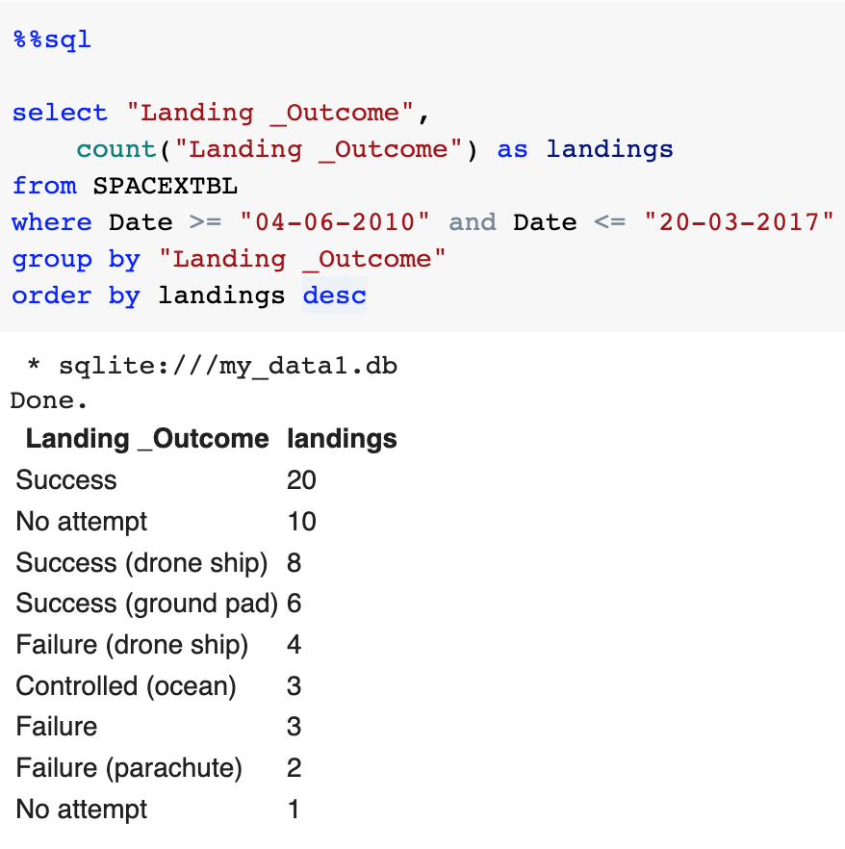
Rank Landing Outcomes Between 2010-06-04 and 2017-03-20
Rank the count of landing outcomes between the date 2010-06-04 and 2017-03-20:
Landing _Outcome | landings
Success | 20
No attempt | 10
Success (drone ship) | 8
Success (ground pad) | 6
Failure (drone ship) | 4
Controlled (ocean) | 3
Failure | 3
Failure (parachute) | 2
No attempt | 1

Slide 36

Section 3

Slide 37
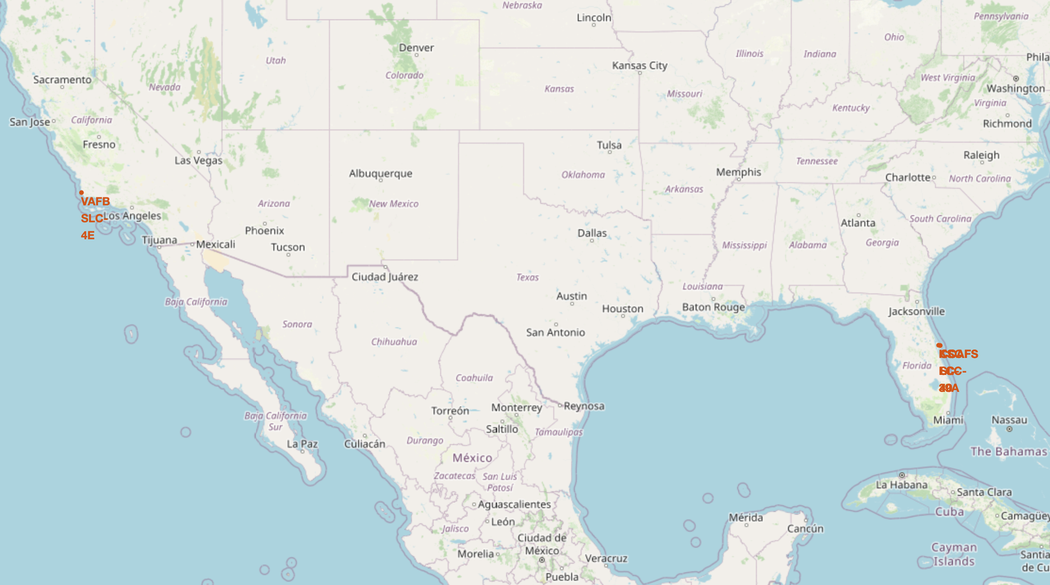
Locations of Launch Sites on Maps
Three in the east
One in the west
All in the south
Launch Site | Lat | Long
CCAFS LC-40 | 28.56230197 | -80.57735648
CCAFS SLC-40 | 28.56319718 | -80.57682003
KSC LC-39A | 28.57325457 | -80.64689529
VAFB SLC-4E | 34.63283416 | -120.6107455

Slide 38
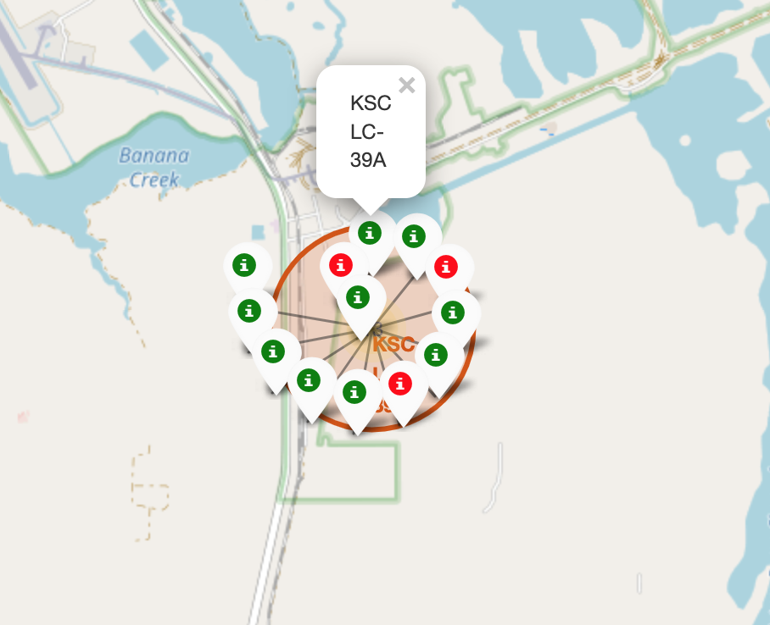
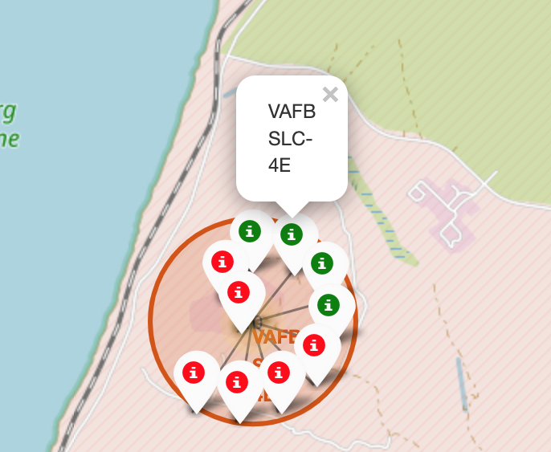
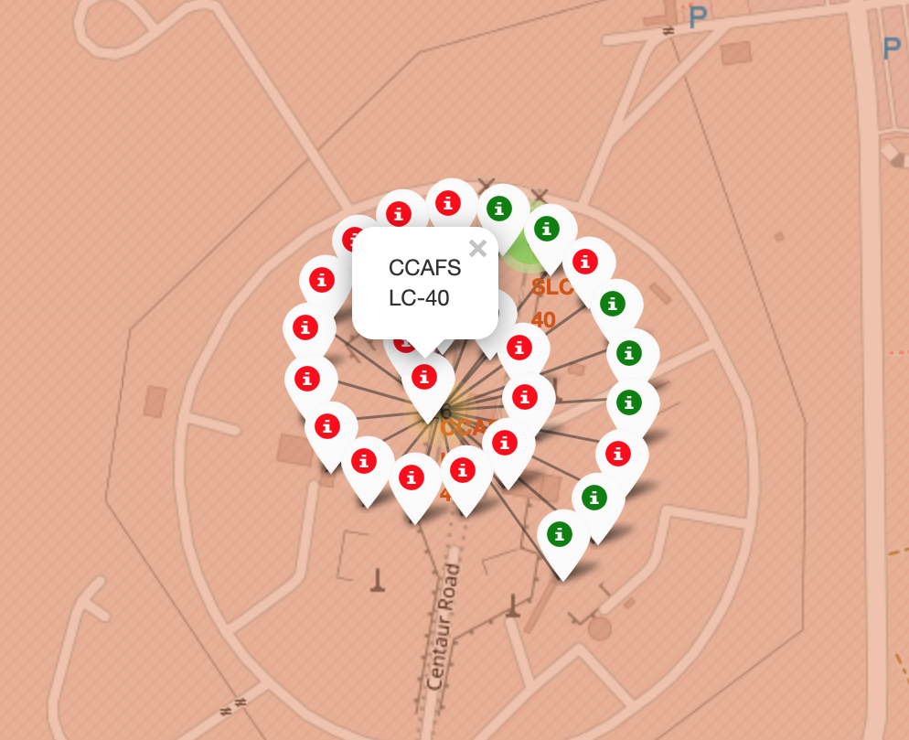
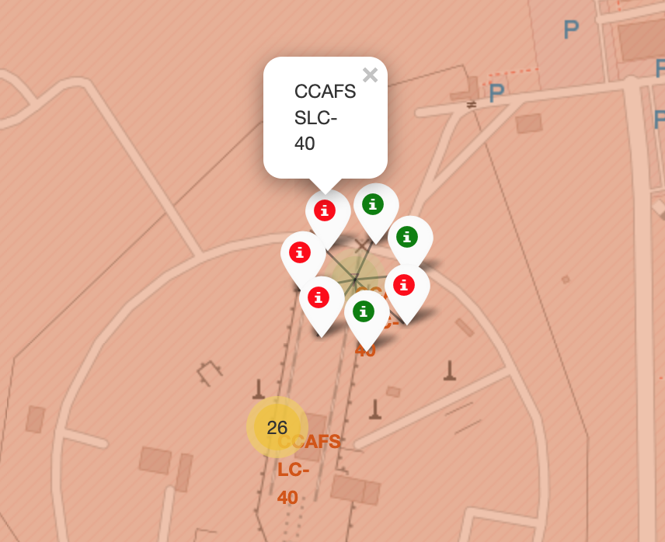
Display Launch Outcome by Color
From the color labels, we can easily see
KSC LC-39A has a rather higher success rate
Whereas CCAFS LC-40 and CCAFS SLC-40 have much lower rate

Slide 39
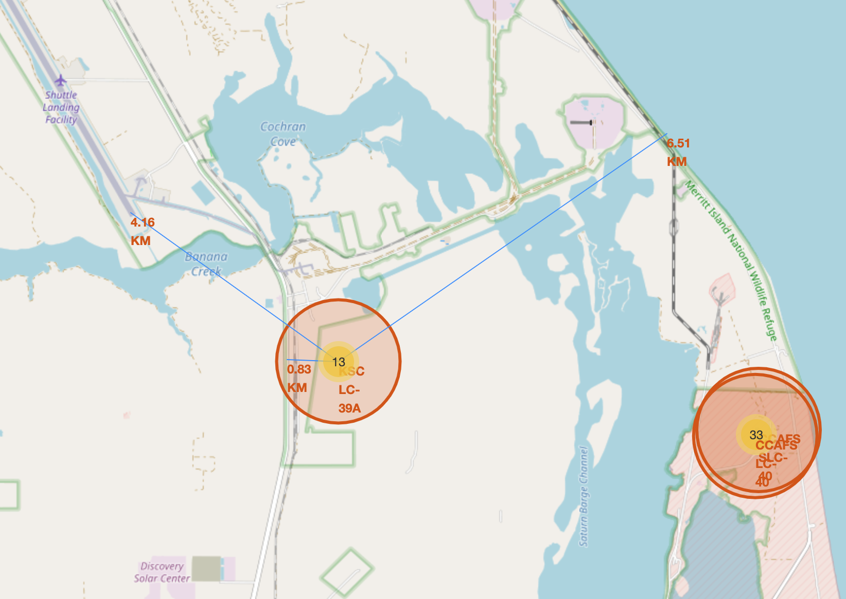
Show Distance to Proximities
The distance from KSC LC-39A to the nearest shuttle landing facility is about 4.16 km.
The distance from KSC LC-39A to the nearest highway is less than 1 km.
The distance from KSC LC-39A to the coastline is around 6.5 km.

Slide 40

Section 4

Slide 41
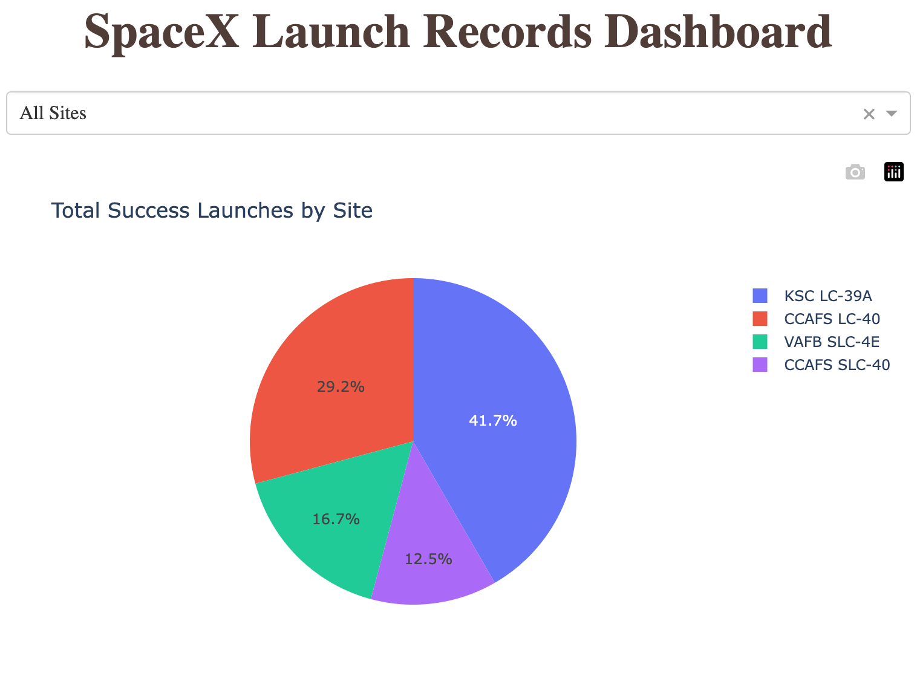
Total Success Launches for All Sites
Total Success Launches for All Sites is
CCAFS LC-40: 29.2%
VAFB SLC-4E: 16.7%
KSC LC-39A: 41.7%
CCAFS SLC-40: 12.5%

Slide 42
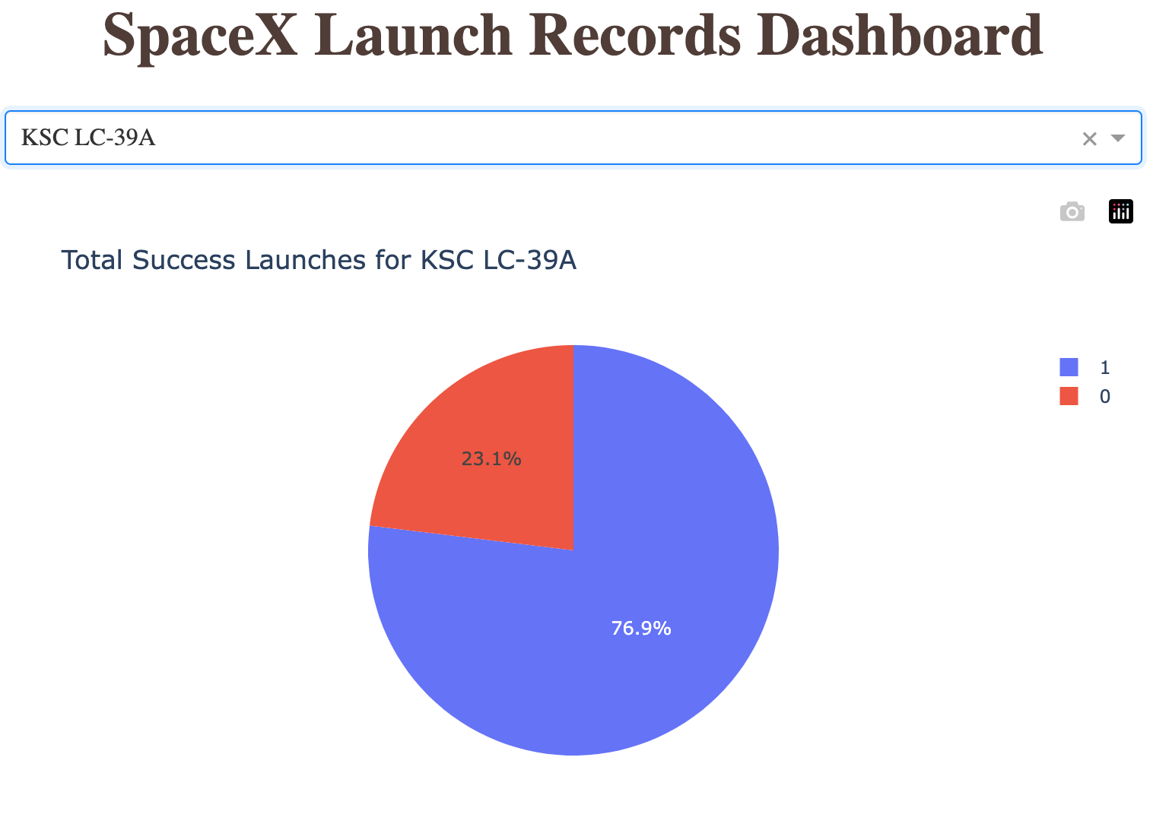
Success Ratio for KSC LC-39A
The launch site with highest launch success ratio is KSC LC-39A.
It has a success rate of 76.9%.

Slide 43
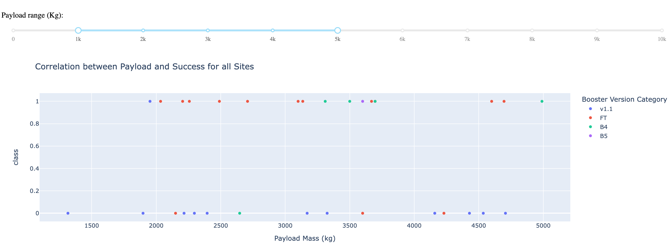
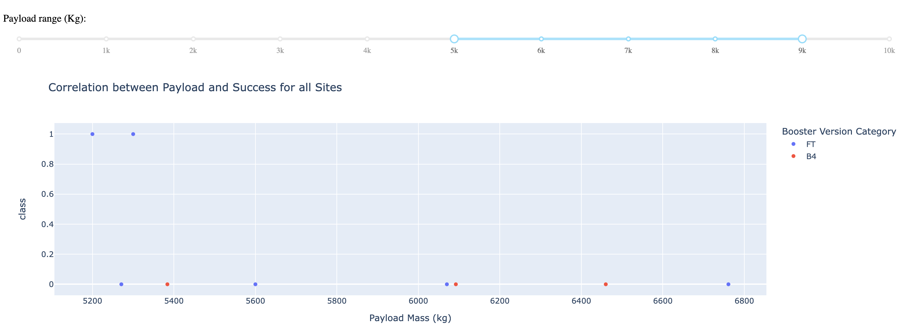
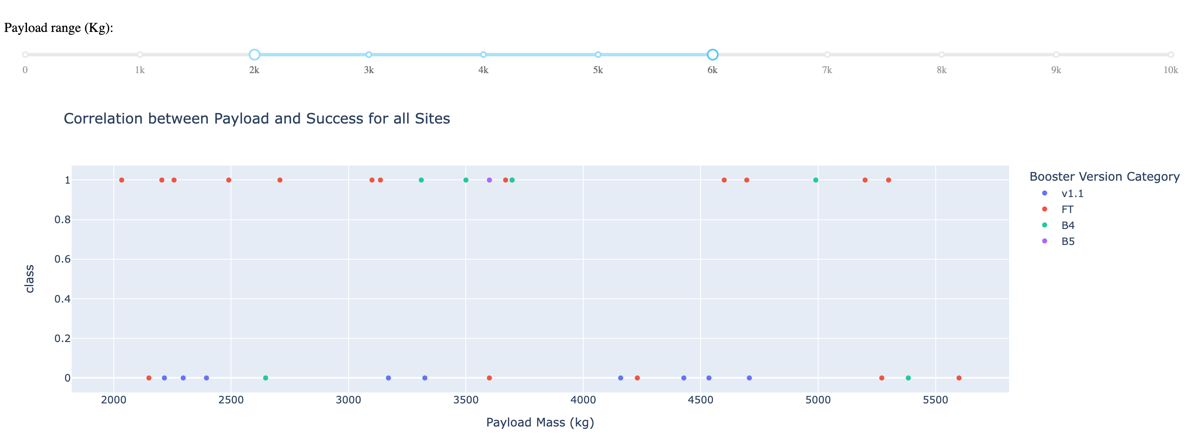
Correlation Between Payload and Success
Payload range in [3000, 4000] has the largest success rate.
Booster version of FT has the largest success rate.

Slide 44

Section 5

Slide 45
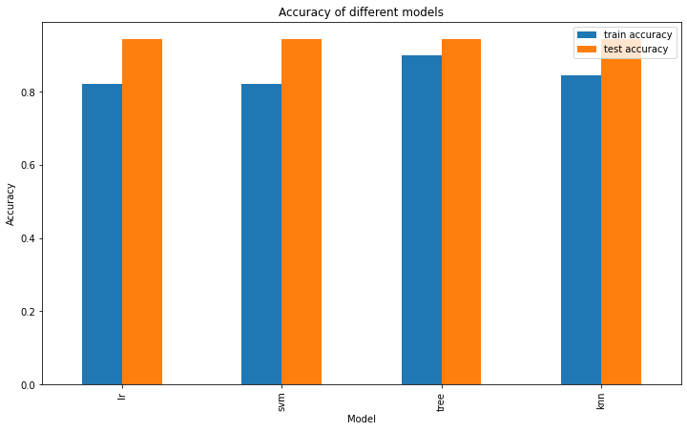
Classification Accuracy
Decision Tree model has the highest classification accuracy
training accuracy 0.9, testing accuracy 0.94
Notes:
Visualize the built model accuracy for all built classification models, in a bar chart
Find which model has the highest classification accuracy

Slide 46
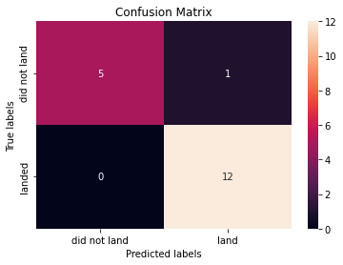
Confusion Matrix
Decision Tree model can distinguish between the different classes.
The major problem is false positives.
Notes:
Show the confusion matrix of the best performing model with an explanation

Slide 47
Conclusions
The shape of the dataset is 90 x 83. With a 80/20 split this gives 72 rows for training data and 12 rows for testing data.
And enhanced by GridSearchCV, we trained four models which have all best performance on test data set.
Of these models, we can choose Decision Tree as our best model for predicting landing outcome of rocket. However there is an issue with false positives which probably will impact our estimation of next bid for rocket launch.

Slide 48


